Slide 1
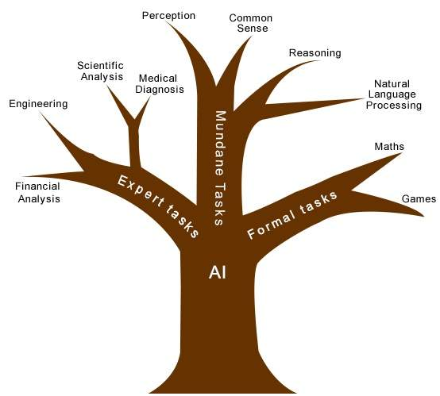
LECTURE 2

Slide 2
Task Domains of AI:
Mundane Tasks
Formal Tasks
Expert Tasks

Slide 3
Mundane Tasks:
Perception
Vision
Speech
Natural Language
Understanding
Generation
Translation
Common sense reasoning
Robot control

Slide 4
Formal Tasks:
Games
Chess
Backhammon
Checks G0
Mathematics
Geometry
Logic
Integral calculus
Proving properties of programs

Slide 5
Expert Tasks:
Engineering
Design
Fault finding
Manufacturing planning
Scientific analysis
Medical diagnosis
Financial analysis

Slide 6
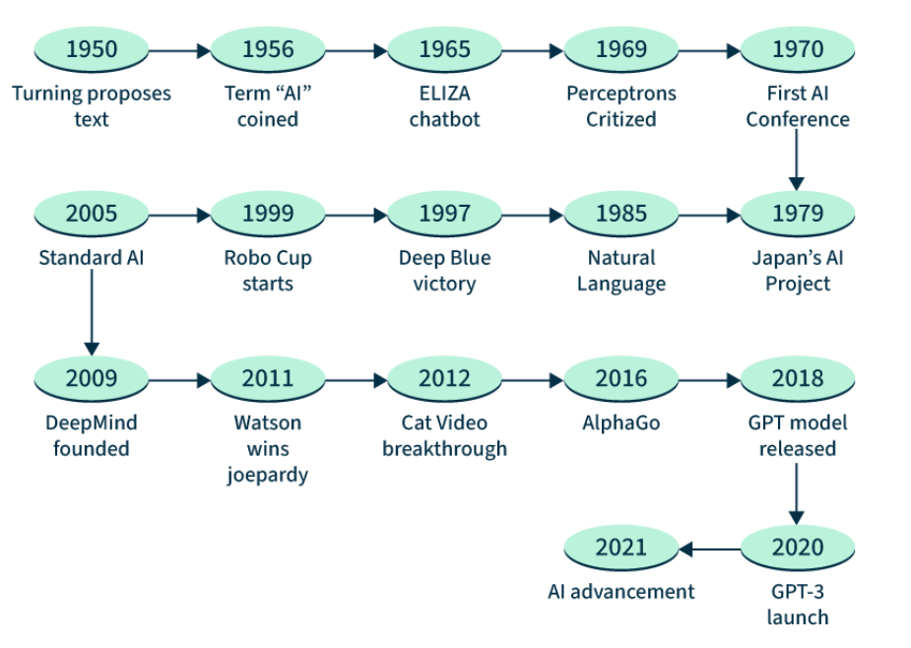
History of AI
2024
2022
GPT-4 Introduced
ChatGPT become widely used

Slide 7
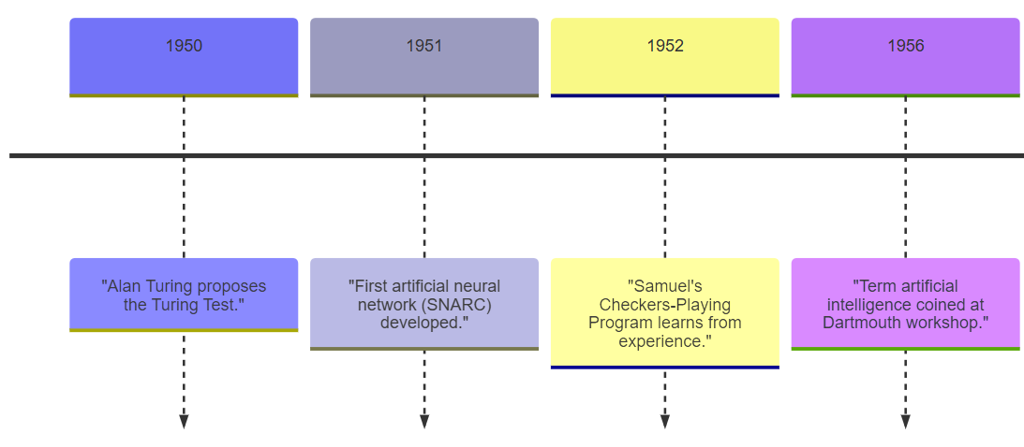
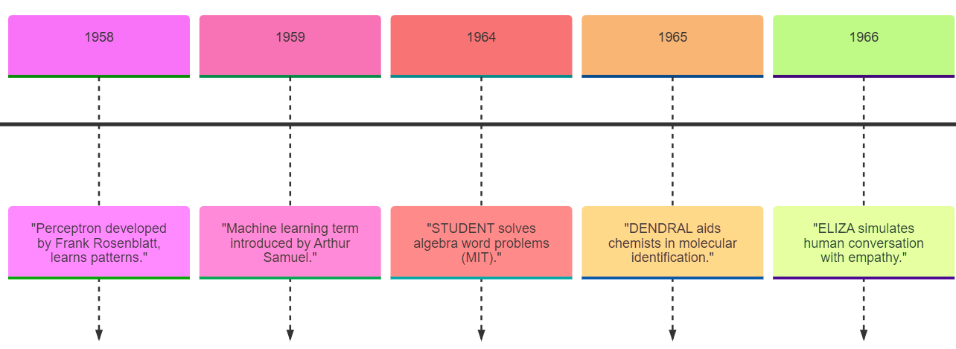

Slide 8
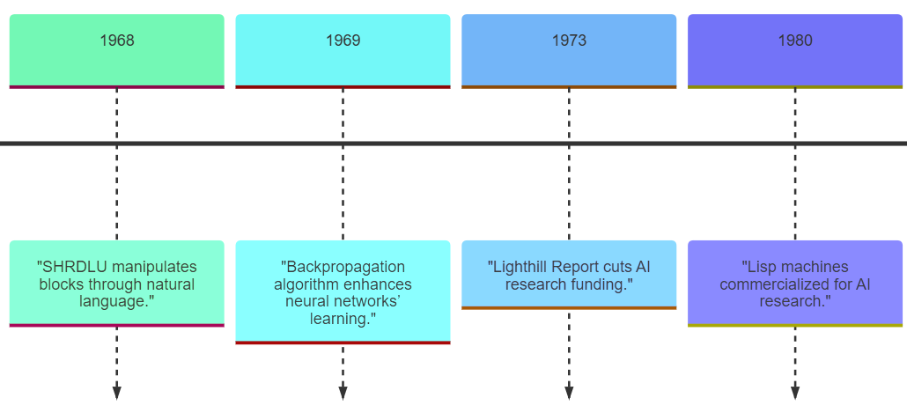
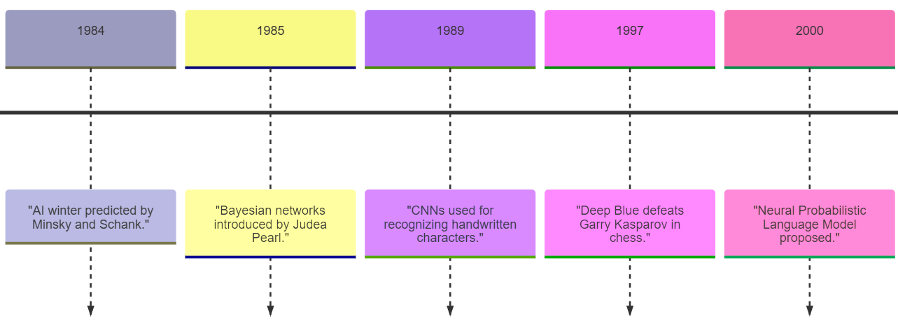

Slide 9
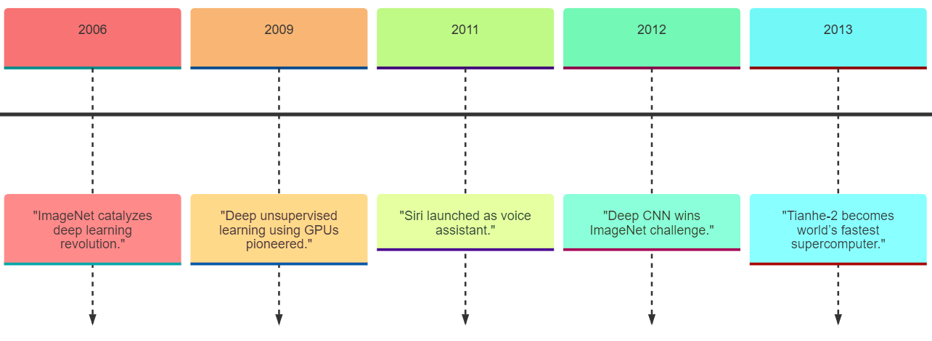
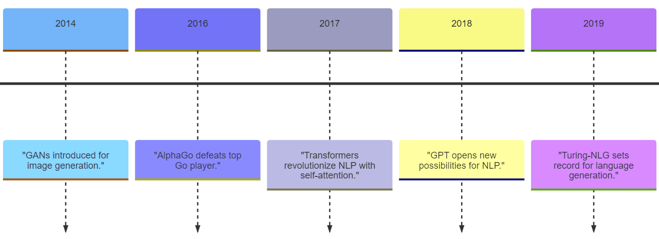

Slide 10
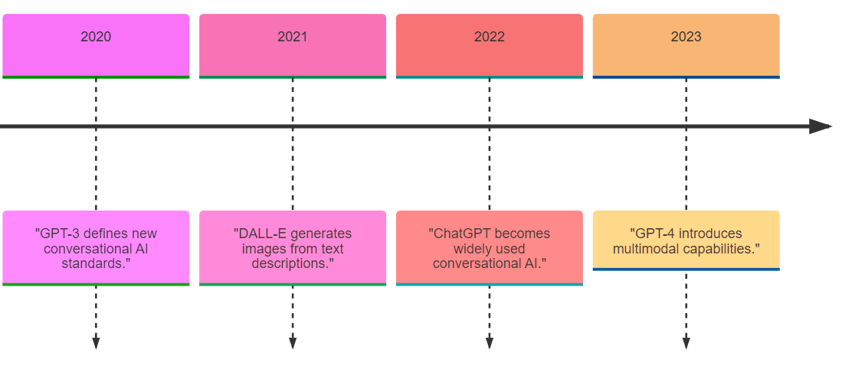

Slide 11

Next: Unlocking the Secrets of AI's Branches!

